Slide 1
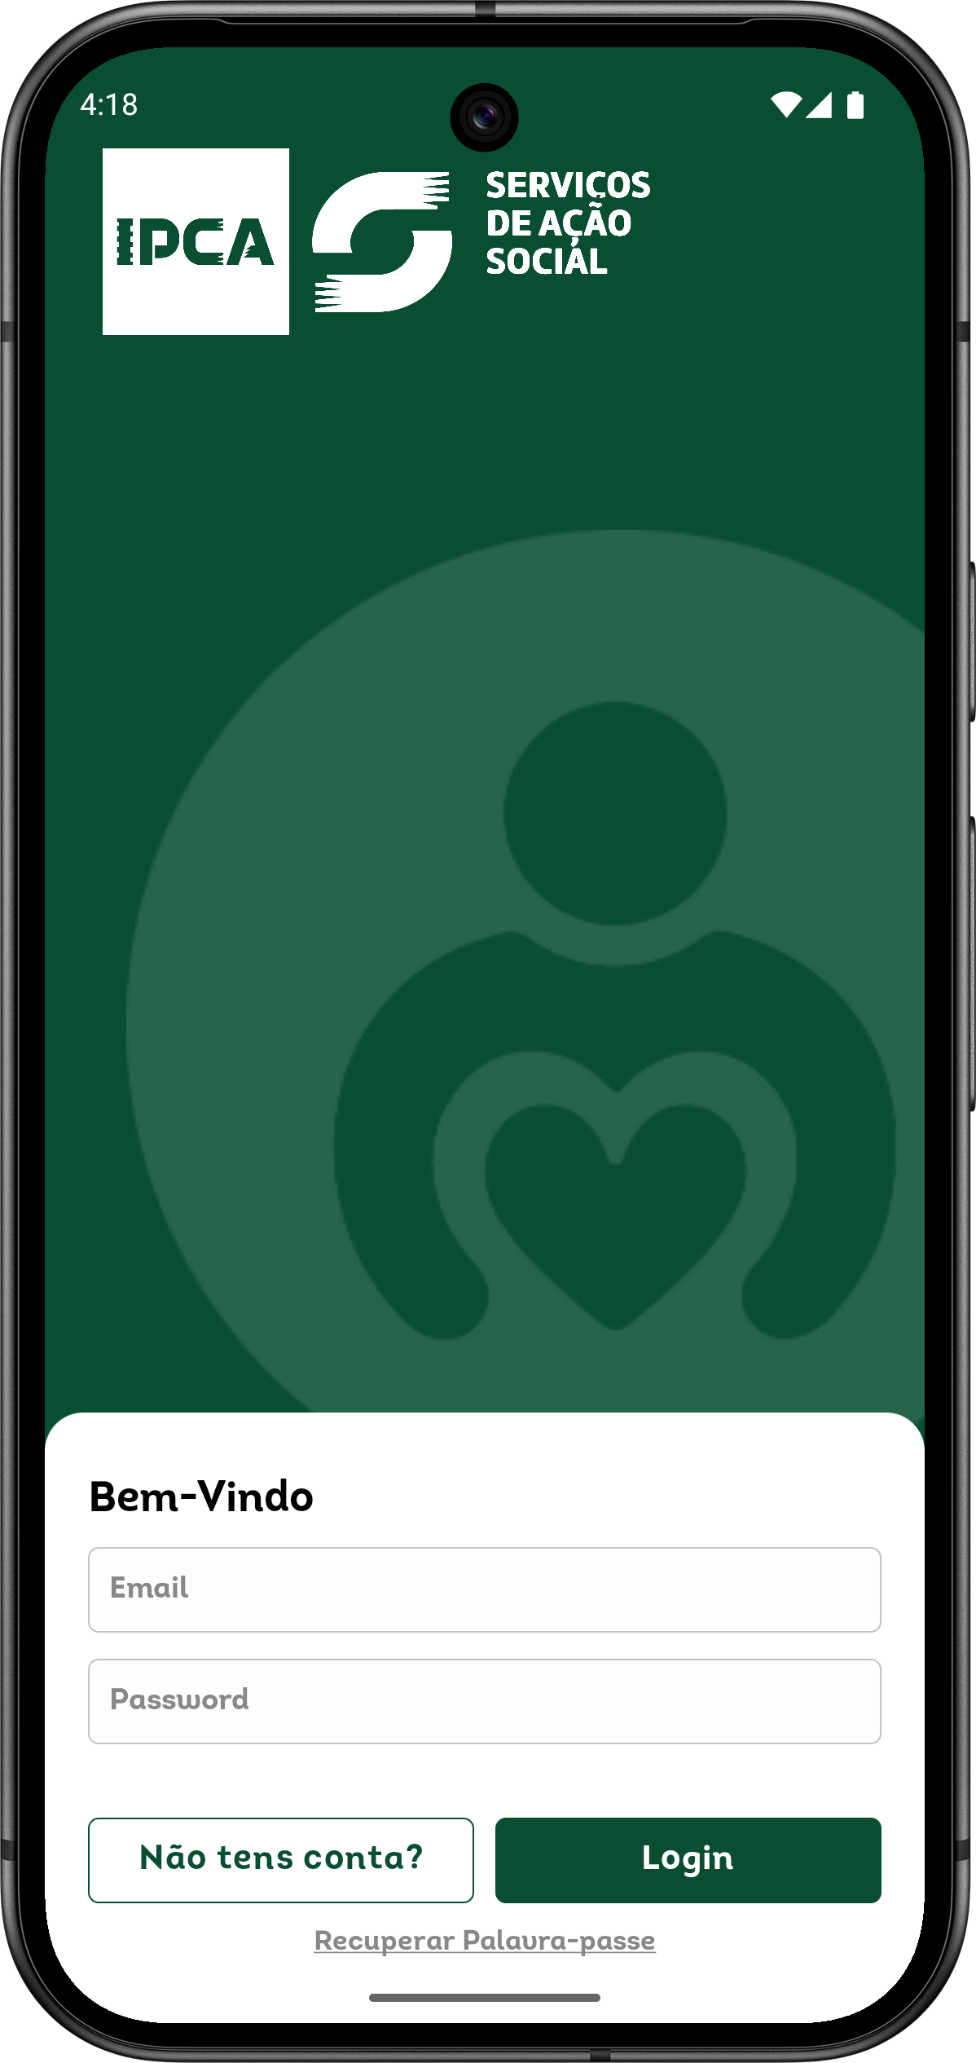
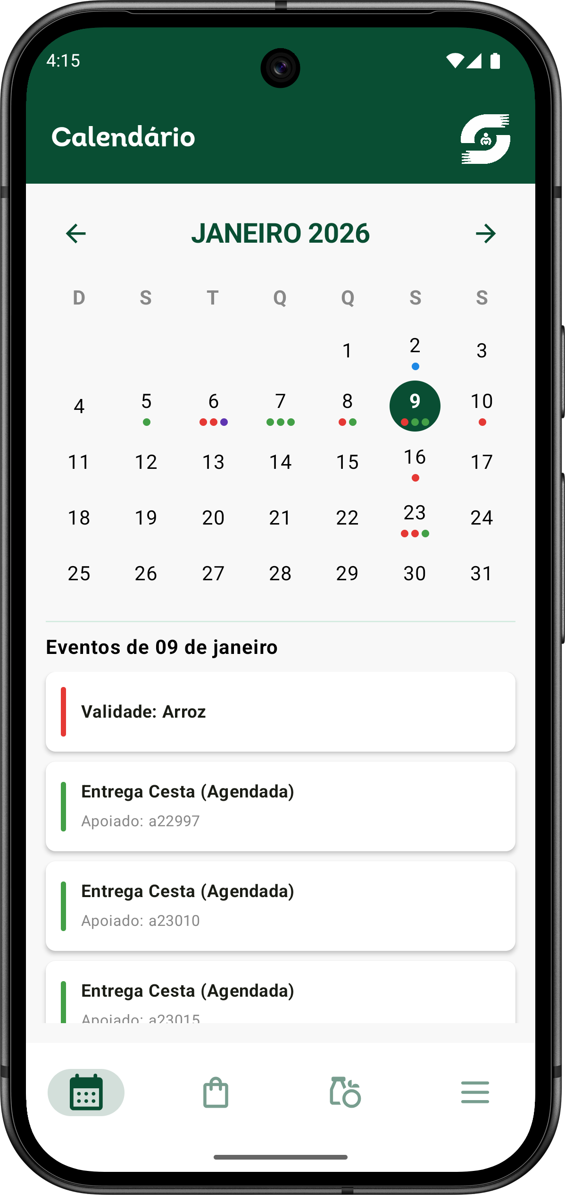
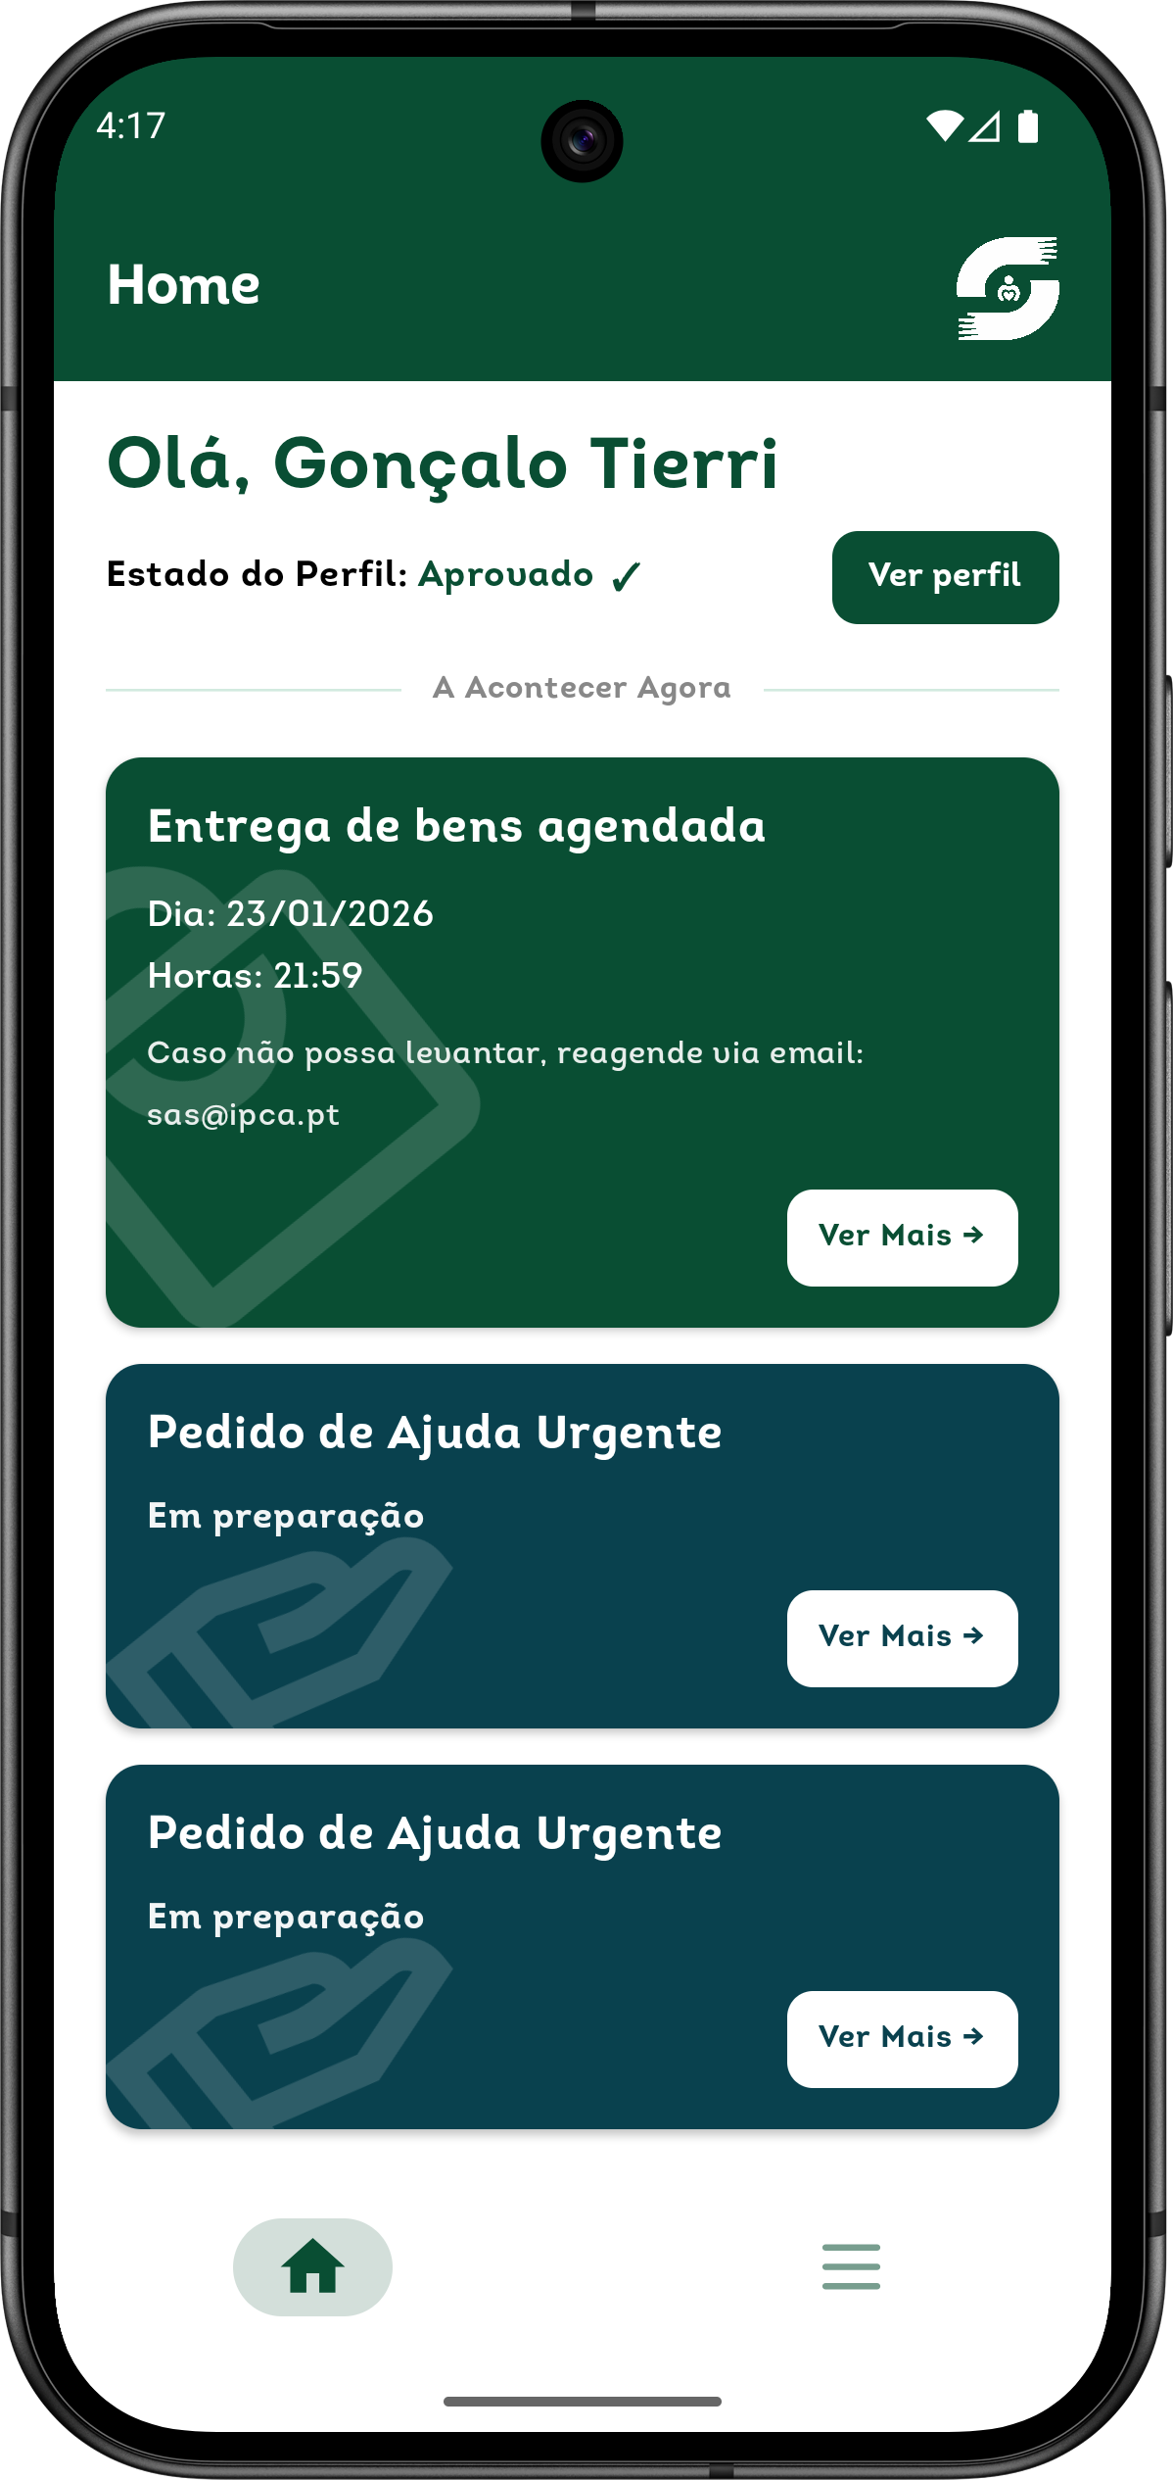
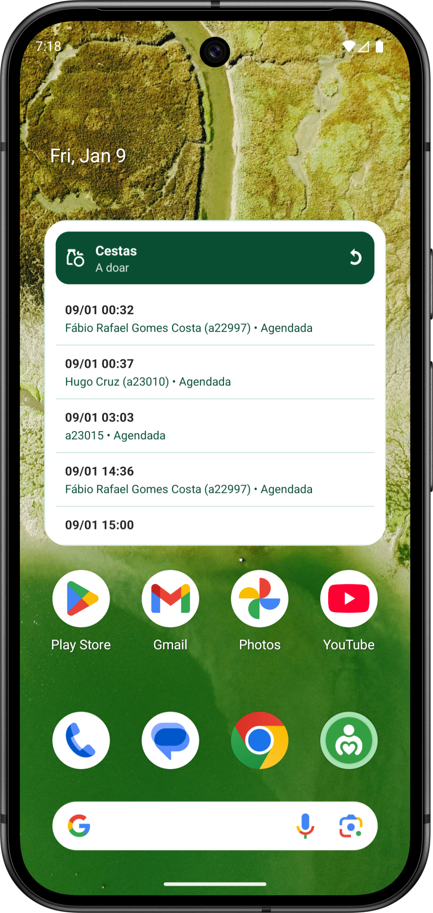


IPCA Social Store: Mobile Application
Fábio Fernandes, Fábio Costa, Luís Freitas, Lino Azevedo, Gonçalo Gonçalves
Supervisors: Patrícia Leite, Lourenço Gomes
BACKGROUND
OBJECTIVES
IPCA’s Social Action Services (SAS-IPCA) support students in vulnerable situations through the Social Store, promoting solidarity, sustainability, and the circular economy.
The management of donations, inventory, and aid allocation is often carried out manually or with dispersed information, leading to difficulties in stock control, delays, and reduced traceability.
This project proposes a digital solution to centralize processes, improve efficiency, and support decision-making.
The solution includes:
An Android app for beneficiaries and staff (internal management and requests);
An informational website to promote campaigns and encourage community participation.
General Objective and Specific Objectives:
Beneficiary management;
Inventory/stock management;
Campaign management;
Aid package (basket) management;
Document submission and validation;
Urgent requests and fast communication between beneficiaries and SAS.
Expected Benefits:
Authentication and role-based profiles (Beneficiary / Staff Member / Administrator);
Real-time synchronization with Firestore;
Automatic notifications;
Data export (PDF/CSV).
TECHNOLOGIES
Mobile App: Android Kotlin + Jetpack Compose (Material 3) + Navigation Compose + Lifecycle ViewModel (Compose);
Firebase (Android SDK): Authentication, Cloud Firestore, Cloud Storage, Cloud Messaging (FCM) (via Firebase BOM);
Barcode/QR: Play Services Code Scanner / ML Kit Code Scanner + ZXing (core);
Backend automation: Firebase Cloud Functions (Node.js 22 + TypeScript) using firebase-functions + firebase-admin;
Website: React + Vite + Firebase JS SDK;
Web UI libs: Chart.js (via react-chartjs-2) + Leaflet/OpenStreetMap (via react-leaflet);
Deployment: Firebase Hosting (web).
CONCLUSIONS
The solution centralizes Social Store management, improving operational efficiency, traceability, and overall control. Automation and push notifications enable a faster response to urgent requests and critical events, such as expiry-date alerts. In addition, the Android app enhances accessibility through home screen widgets (e.g., scheduled baskets/deliveries), providing essential information at a glance. Future work includes broader user testing, more comprehensive reports and indicators, and strengthened permissions and security.
Login: Authentication screen for secure access.
Collaborator home: Collaborator dashboard for daily operations.
Beneficiary home: Beneficiary dashboard with key updates.
Widget: Home- -screen widget with upcoming schedules.
CONTACTS - STUDENTS
a22996@alunos.ipca.pt (Fábio Fernandes)
a22997@alunos.ipca.pt (Fábio Costa)
a23008@alunos.ipca.pt (Luís Freitas)
a23015@alunos.ipca.pt (Lino Azevedo)
a23020@alunos.ipca.pt (Gonçalo Gonçalves)
CONTACTS - SUPERVISORS
patricialeite@ipca.pt (Dra. Patrícia Leite)
lgomes@ipca.pt (Eng. Lourenço Gomes)
REPOSITORY - GITHUB

